Slide 1

Movie Rating Model
Predictive Modeling Final Presentation
Team:
Amit Gangrade, Gargi Yadav, Juhi Maheshwari
Akshata Nayak, Gaurav Sharma, Shobana Ravichandran
17th April 2018

Slide 2
Problem Statement
Predicting the success of a movie is a huge concern for directors and producers who are looking for financial returns and credibility.
Devising a method which can predict not only the success of the movie but also help understand what factors contribute to the success of the movie could really benefit the film industry.
This will enable the producers to focus on their advertising campaigns. It also help them to find the most appropriate time to release a movie by looking at multiple factors.
Through this project, we want to leverage predictive analytics to enhance the box office success rate for the movie.

Slide 3
Introduction:
The project analyzes the Movie dataset which predicts the Imdb score and Success rate of Movie
It contains 28 variables for 5043 movies between years 1916 to 2016 spread across 59 countries.
This dataset consist of various fields including some of the key fields such as – Budget of movie, Gross amount, Imdb score, etc.
Target Variable: Imdb Score, Movie Hit/Flop
Objective: Rating of the Movie and Yes/No analysis of whether the movie is Hit/flop based on various factors
Business value: This prediction can be used for finding success factor of a movie based on real-time variables.

Slide 4
Data Cleaning
A) Resolve inconsistencies:
Deleted the 16 rows of data which were having no. of missing columns greater than 8
B) Dealing with missing values :
Column name | Missing value action
color | 19 row had missing value which got imputed to color if yr >1940
duration | 20 rows imputed manually
director_name | 96 rows had missing value. Deleted the rows
actor_3_name | 9 rows had missing value. Deleted the rows
content_rating | 186 rows had missing value which got imputed with rating as Unrated
budget | The missing rows of Budget is recoded with Median 20000000. The existing outlier increases the mean value. Hence did not impute with the mean value, instead imputed with median.
gross | The missing rows of Gross is recoded with the mean value 40718315, since the data is widespread

Slide 5
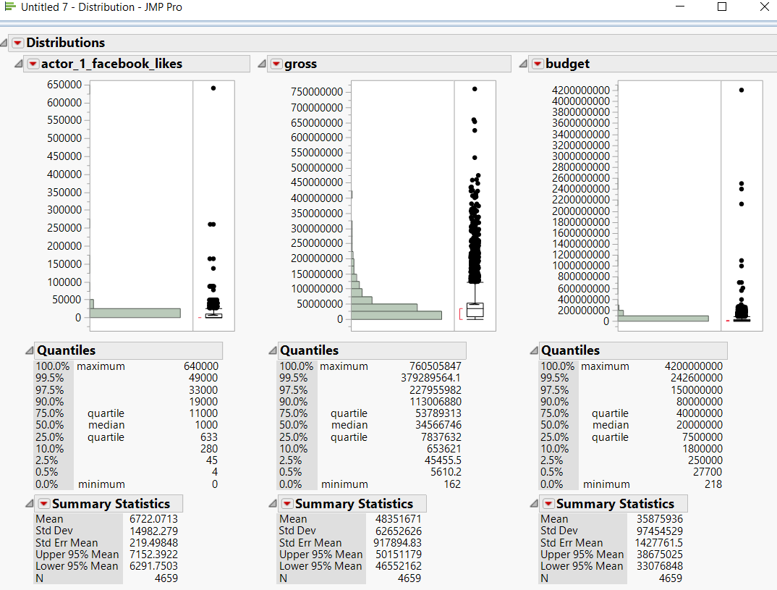
Data Cleaning
C) Handling Outliers :
Column name | Handling Outliers
actor_1_facebook_like | Excluded two values of outliers(650000 , 260000). These date seems erroneous based on actual facebook likes
Gross | The Outlier here is Avatar movie and its Gross income is correct.
Budget | The outlier here is 4200000000 for the movie Lady Vengeance, excluded it from the dataset

Slide 6
Data Transformation
Variable transformation
The variable facenumber_in_poster is changed from continuous to categorical variable.
New Column data :
Column name | Column value description
Content_rating 2 | This is a new Column variable created whose value is segregated into four categories. The column value is created based on the combination of original content_rating and countries.
Total movie team Facebook likes | This column is created by adding the facebook likes of the columns - actor_1_facebook_likes,actor_2_facebook_likes,actor_3_facebook_likes, director_facebook_likes
Popularity % of actors and directors - actor_1_facebook_popularity, actor_2_facebook_popularity, actor_3_facebook_popularity, Director_Facebook_popularity | The popularity percent is calculated by dividing the No of facebook likes of respective actor and director by the Total Facebook likes. For eg : actor_1_facebook_popularity = actor_1_facebook_likes /Total movie team Facebook likes
Profit percent | This Column is created based on budget and gross. Profit percent = (Gross-Budget)/Budget
Profit | If the Profit percent is positive the Profit value is set a '1'. If the profit percent is not positive , the Profit is set as '0'.
Budget | Transformed all the different currencies into a common currency – US Dollar

Slide 7
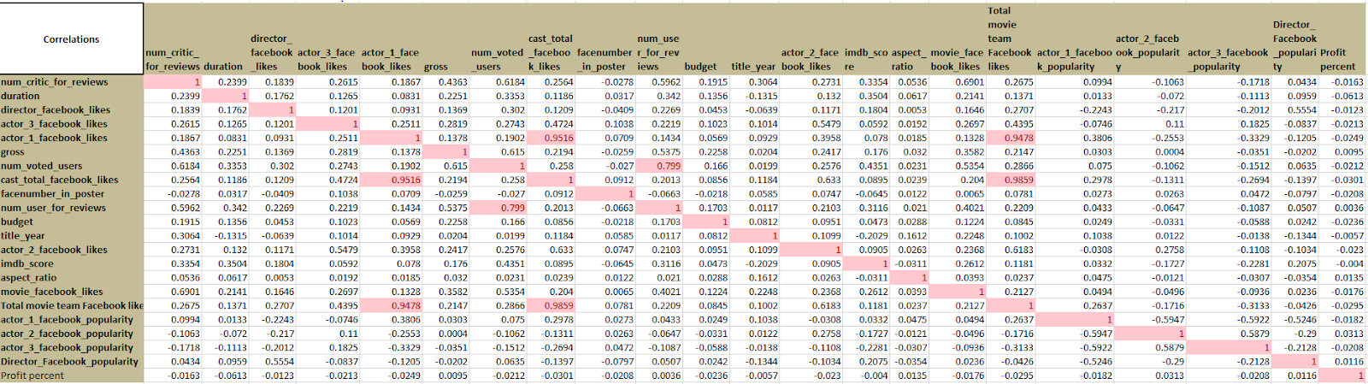
Correlation in Movie Data
Positive correlation between the following variables:
1. actor1_facebook_likes and cast_total_facebook_likes
2. num_voted_users and num_users_for_reviews
3. cast_total_facebook_likes and Total_movie_team_facebook_likes
4. actor1_facebook_likes and Total_movie_team_facebook_likes

Slide 8
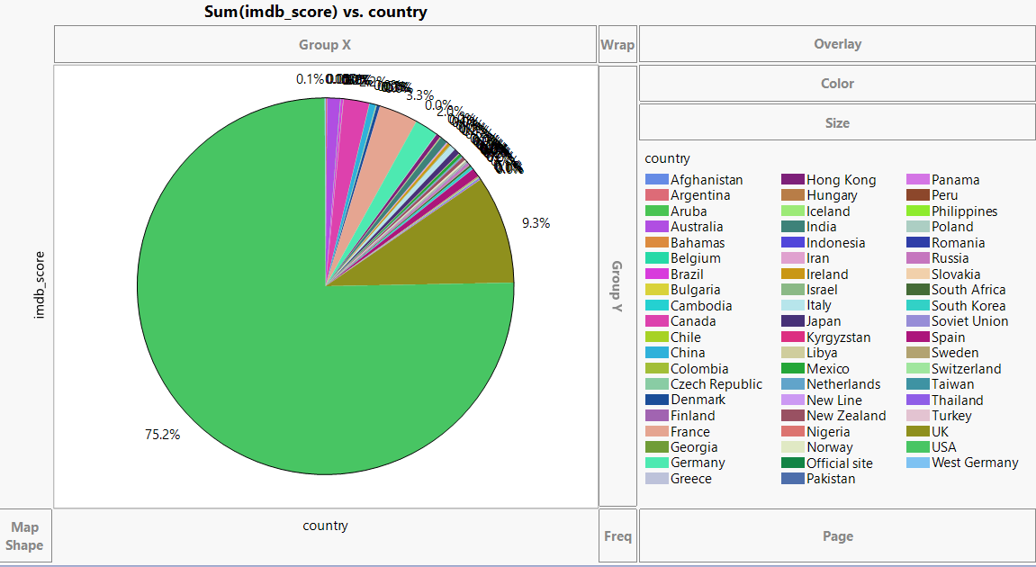
Visualization in Movie Data

Slide 9
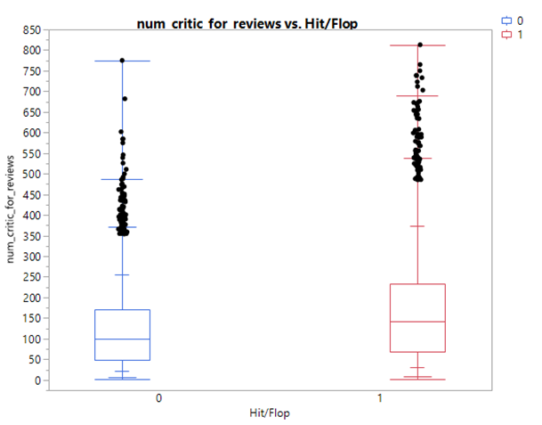
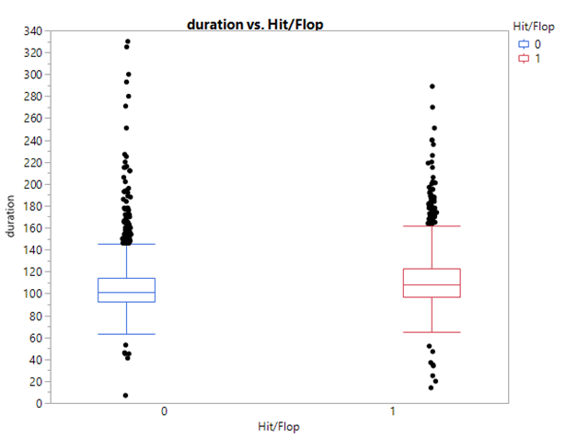
Visualization in Movie Data

Slide 10
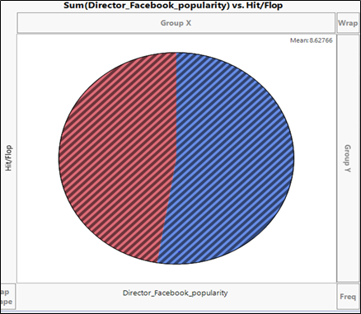
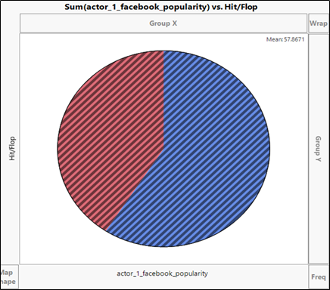
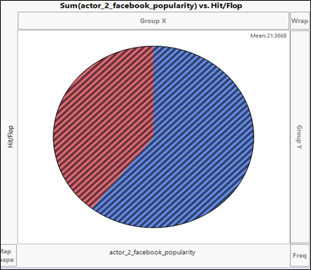
Visualization in Movie Data

Slide 11
MODEL BUILDING

Slide 12
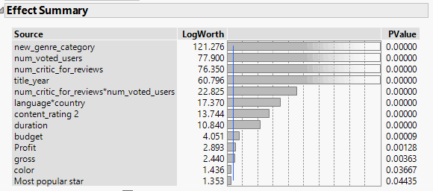
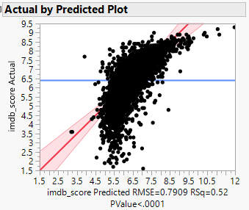
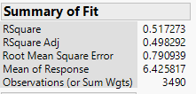

Movie Rating - Linear Regression Model
Inference :
RSquare of the Validation Model is 47% .
RASE for the Model is 78.34 %

Slide 13
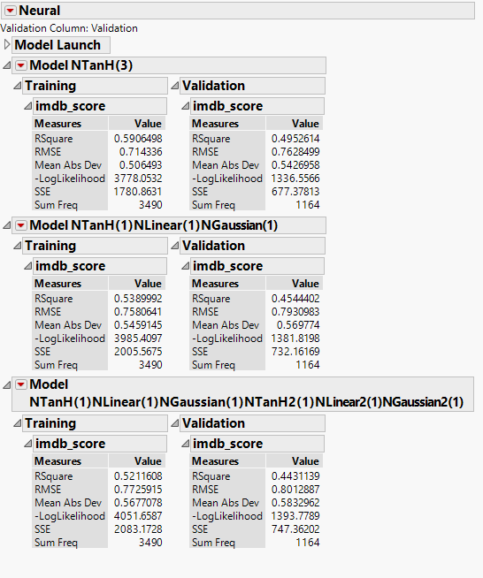
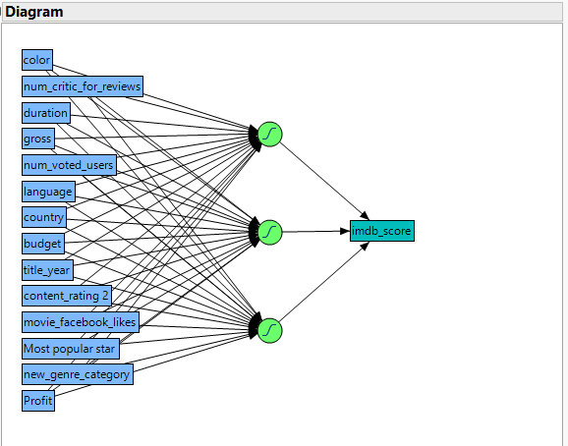
Movie Rating - Neural Networks
Inference :
The best RSquare of the three Neural Models on Validation dataset 49.5% .
Single layer - NTanH (3)
RMSE for the Model is 76.28 %.

Slide 14
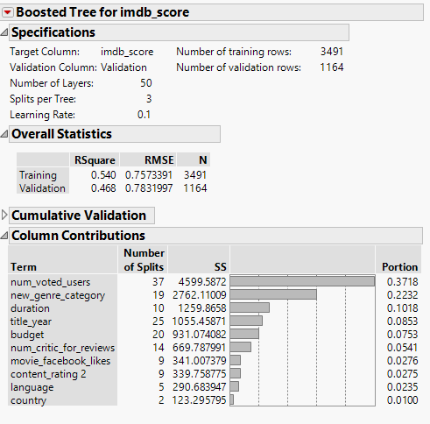
Movie Rating - Boosted Trees
Inference :
RSquare of Validation Model is 46.8% .
RMSE for the Model is 78.3%.

Slide 15
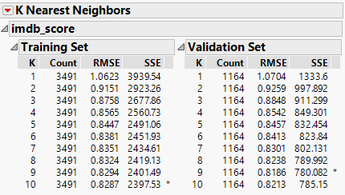
Movie Rating - K Nearest Neighbor
Inference :
RSquare of the Training Models is 56.09% ,
Validation Model is 41.87% .
RASE for the Model is 81.86%.

Slide 16
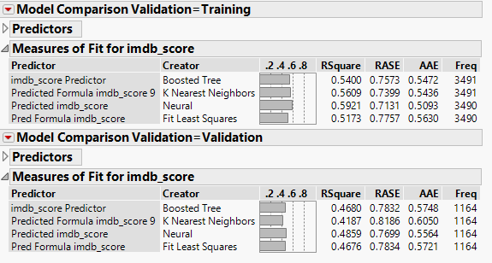
Movie Rating – Model Comparison
Inference :
The neural network has the best value for Rsquare.
From the Model comparison, we can see that the Neural network has the predictor variables to predict the Movie ratings better.

Slide 17
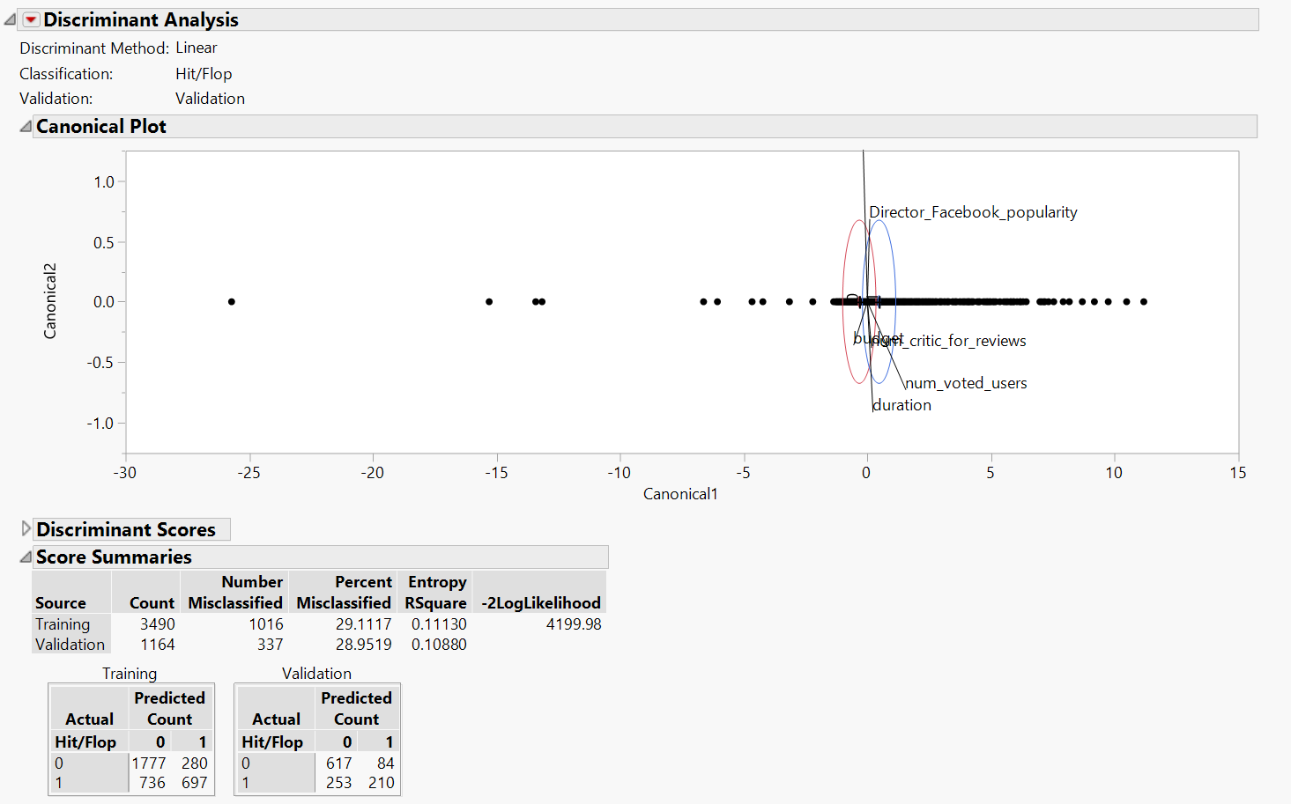
Movie Hit/Flop - Discriminant Analysis
Inference :
Model accuracy of Validation dataset is : 71.04% whereas Model accuracy of Training Dataset is 70.89%.

Slide 18
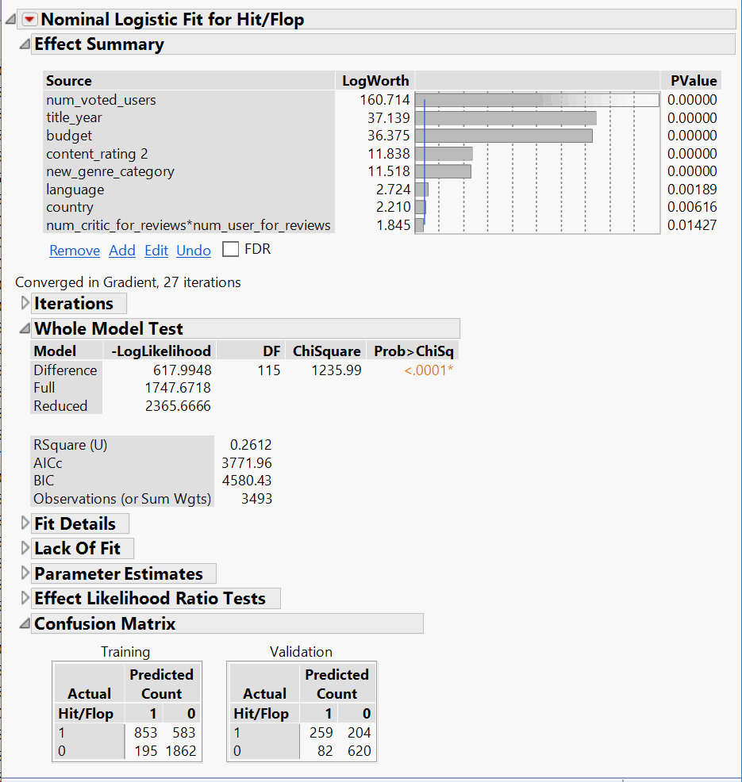
Movie Hit/Flop - Logistic Regression
Inference :
R-Square = 26%
Model Accuracy = 75.45%
Model accuracy for Training data is 77.72 %., hence accuracies are consistent between Training and Validation datasets.

Slide 19
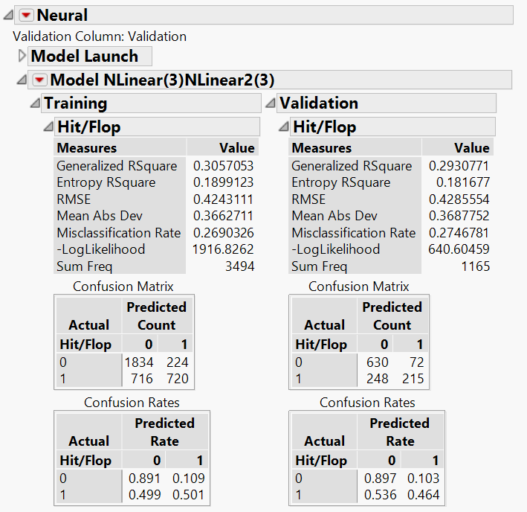
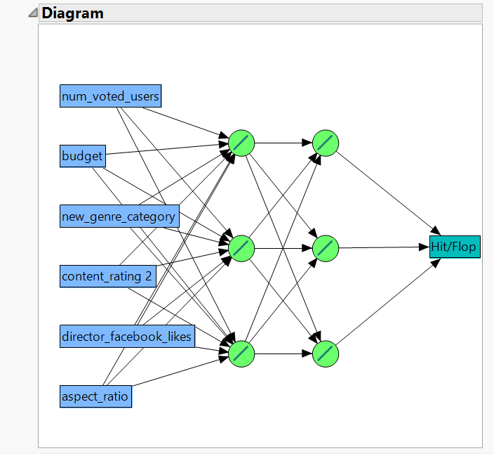
Movie Hit/Flop - Neural Network
Inference:
RSquare of the Training and Validation Models are 30.57% and 29.30% respectively.
Model accuracy of Validation dataset is : 72.53% whereas Model accuracy of Training Dataset is 73.09%.

Slide 20
Movie – Hit or Flop ?
Logistic Regression Model gives the highest accuracy in Training and Validation datasets .
Logistic Regression Model with the Predictor variables : num_voted_users, title_year, budget, content_rating2, new_genre_category, language, country, num_critic_for_reviews*num_user_for_reviews
These predictor variables of Logistic regression predicts Movie success(Hit/Flop) better than the other model.

Slide 21
Recommendation & Conclusion
The number of voted users is an important factor impacting movie success.
Budget is important and there is a strong correlation between budget and movie rating.
The top two countries contributing to highest number of IMBD score are US and UK with 75.2 and 9.3% respectively.
In the Movie dataset, for predicting whether the Movies are a Hit or Flop - the predictor variables from Logistic Regression predicts better than other model.
For predicting the IMDB Score, the Neural network is the best model.

Slide 22

Let’s Play a quick quiz..

Slide 23
Let’s Play a quick quiz..
It’s a Hit !

Slide 24

Let’s Play a quick quiz..

Slide 25
Let’s Play a quick quiz..
It’s a Flop !

Slide 26
References
Source: https://data.world/popculture/imdb-5000-movie-dataset
https://nycdatascience.com/blog/student-works/web-scraping/movie-rating-prediction/
https://help.imdb.com/imdb?ref_=cons_nb_hlp
http://usir.salford.ac.uk/18838/1/Wessex_movie.pdf

Slide 27
Appendix
Original Dataset referenced for above analysis :
https://data.world/popculture/imdb-5000-moviedataset
The processed datasets for continuous and categorical variable is shared in the white paper.

